Slide 1
Final Engagement
Attack, Defense & Analysis of a Vulnerable Network
Sujan Mathur, Ethan Mottaz, Alex Palmer,
Giovanni Lopez-Toledano, Justin Paro,
Daniel Braaten, Tyber Pettie, Kyle Nathe

Slide 2
Table of Contents
This document contains the following resources:
Network Topology & Critical Vulnerabilities
Exploits Used
Methods Used to Avoiding Detect

Slide 3

Network Topology
& Critical Vulnerabilities
3

Slide 4
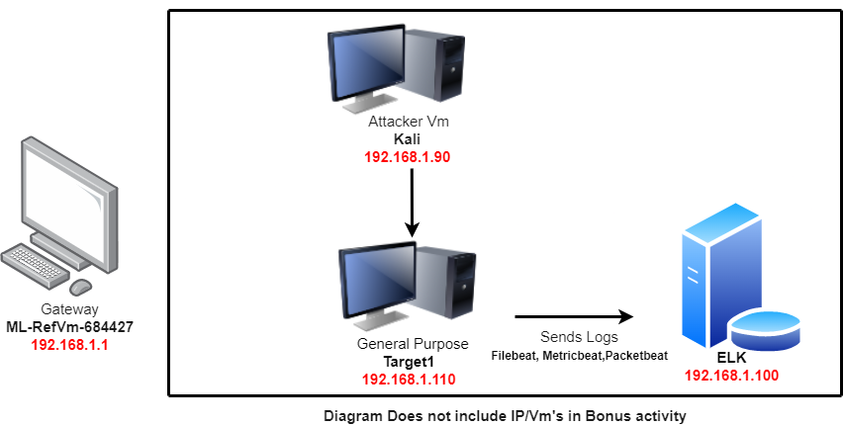
Network Topology
[Insert Here]
Use draw.io to create a diagram of the network.
Add your diagram to this slide and fill out the data in the sidebar.
Network
Address Range:192.168.1.0/24
Netmask: 255.255.255.0
Gateway: 192.168.1.1
Machines
IPv4:192.168.1.90
OS: Kali Linux 2.6
Hostname:Kali
IPv4:192.168.1.100
OS:Ubuntu 18.04.4
Hostname:Elk
IPv4: 192.168.1.110
OS: Linux 3.2 - 4.9
Hostname:Target1
IPv4:192.168.1.105
OS: Ubuntu
Hostname: Capstone

Slide 5
Critical Vulnerabilities: Target 1
Our assessment uncovered the following critical vulnerabilities in Target 1.
Vulnerability | Description | Impact
A02:2021-Cryptographic Failures | Sensitive information including usernames, hashed passwords, and other files were accessible and used to gain further access | By gaining access to sensitive information. were able to gain user information for Michael and Steven. Allowing us to gain further access.
A07:2021-Identification and Authentication Failures | Uses weak passwords ‘michael:michael’, and stored hashed passwords that can be easily cracked. | by ssh to michael account we were able to access /var/www/html/wordpress to find and cat into wp-config. Which were able to gain Mysql password
A01:2021-Broken Access Control | User can gain root privilege using python. | Gaining root privilege without credentials allows for modification of system files and services.

Slide 6
Exploits Used
6

Slide 7
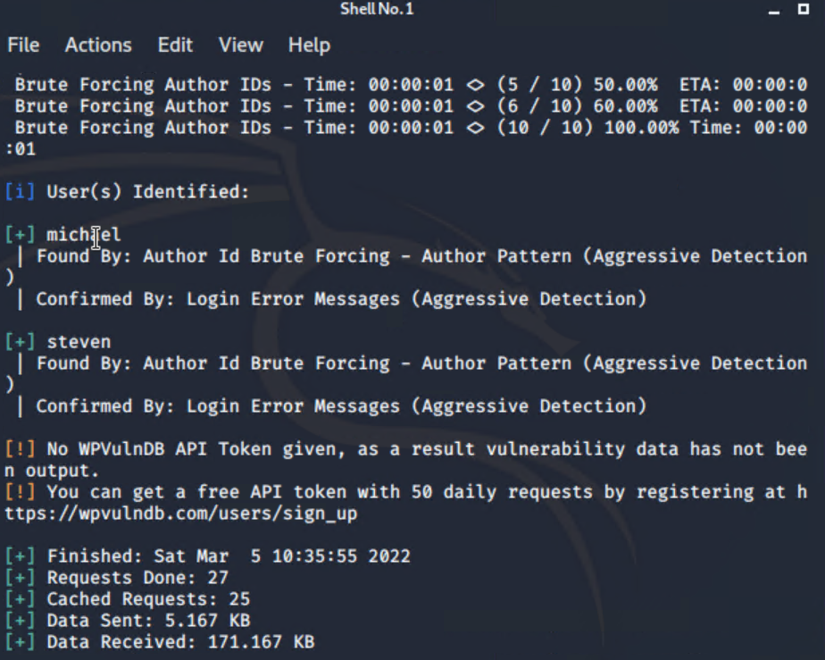
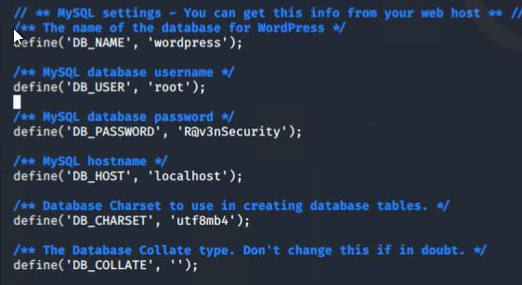
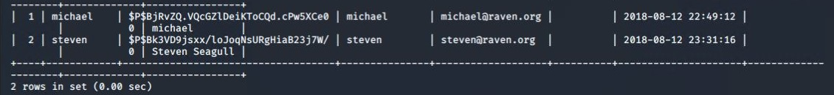
Exploitation: A02:2021-Cryptographic Failures
Summarize the following:
After enumerating the WordPress site to get a list of users, Michael’s password was easily guessable (michael).
Using Michael’s information to SSH into the target machine, navigating to `/var/www/html/wordpress` and using `cat wp-config.php` reveals the password for the mysql database.
Using the password for the MySQL database, we were able to discover a hashed password for the user Steven.

Slide 8
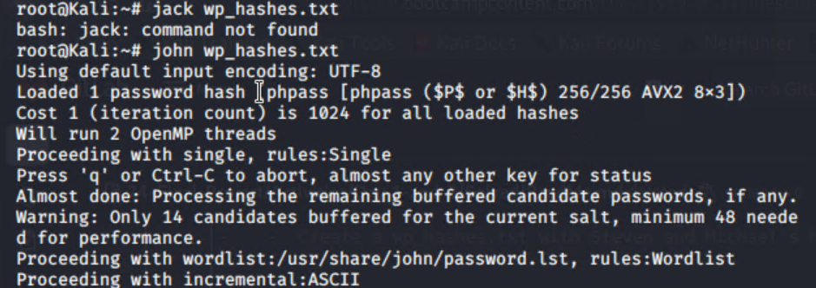
Exploitation: A07:2021-Identification and Authentication Failures
Easily guessed user passwords (michael:michael) and hashed passwords in plaintext can be cracked and be used to gain access to sensitive information
Using this information we were able to gain access to the MySQL database, Stevens hashed password, and SSH connections with both Steven and Michaels credentials.

Slide 9
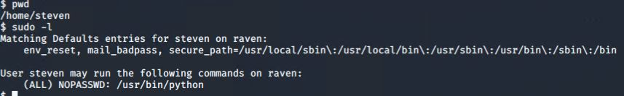
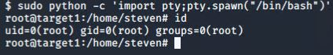
Exploitation: A01:2021-Broken Access Control
Summarize the following:
After cracking Stevens password using John the Ripper, and using the credentials to SSH into the target machine, Steven can be escalated to root using Python
By using this exploit we were able to get Root access

Slide 10
Avoiding Detection
10

Slide 11
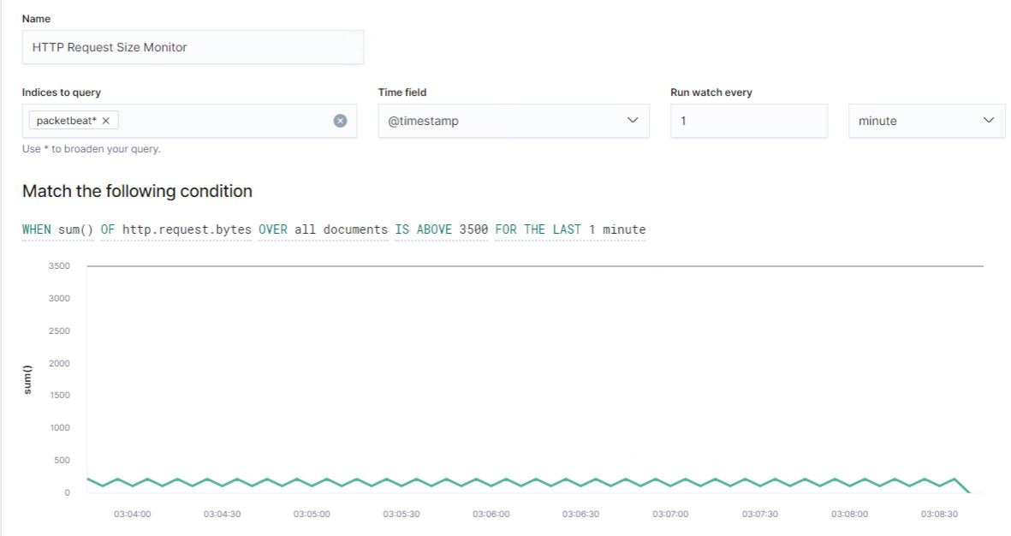
Stealth Exploitation of Network Enumeration
Monitoring Overview
Which alerts detect this exploit?
HTTP Request size monitor
Which metrics do they measure?
The amount of data transferred
Which thresholds do they fire at?
HTTP Request size over 3500 bytes over the last 60 seconds
Mitigating Detection
How can you execute the same exploit without triggering the alert?
Specify the ports we want to scan instead of scanning the top 1000 ports. In other words, only scan the ports that have known vulnerabilities.
We could explore different and more conservative “nmap” timing strategies that would limit the requests sent thus reducing the size.

Slide 12
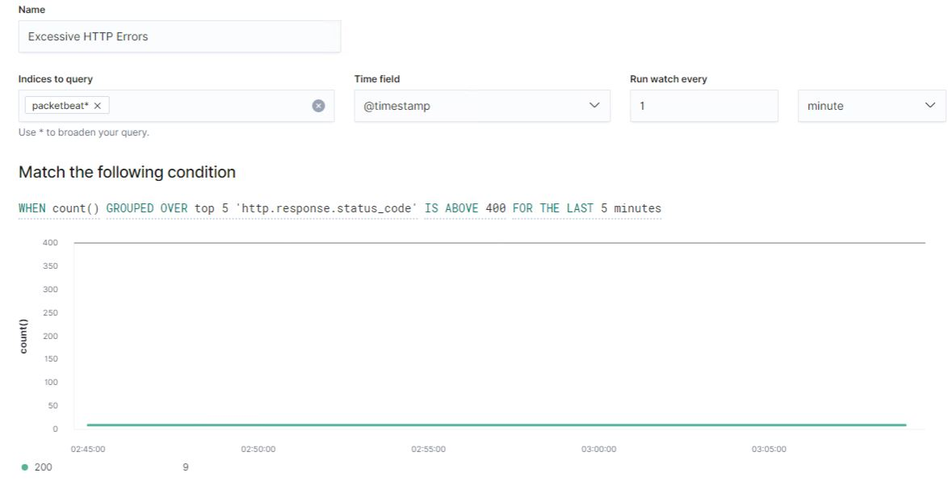
Stealth Exploitation of Wordpress Enumeration
Monitoring Overview
Which alerts detect this exploit?
Excessive HTTP Errors
Which metrics do they measure?
Client Error Responses
Which thresholds do they fire at?
When the total count of the top 5
`http.response.status_code` is greater than 400 for the last 5 minutes.
Mitigating Detection
How can you execute the same exploit without triggering the alert?
We could use the “throttle” option in “WPScan”
Are there alternative exploits that may perform better?
We could use the “stealth” option in “WPScan”

Slide 13
Stealth Exploitation of Password Cracking
Mitigating Password Exploits
Require more complex passwords
Implement Multi-factor authentication
Lock down SSH access by requiring asynchronous keys in place of passwords

